Slide 1
Python Turtle
Lesson B.9

Slide 2
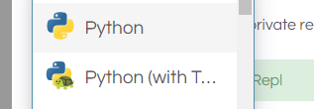
New Repl
Open a new repl.
Select the "Python with Turtle" language

Slide 3
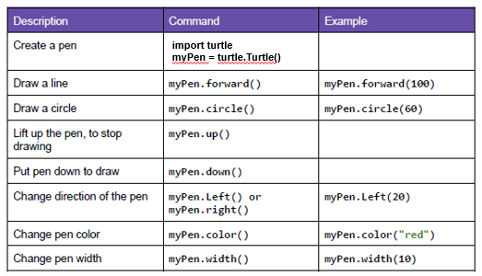
Turtle Commands
These are the Beginning Commands
Google for more advanced options

Slide 4
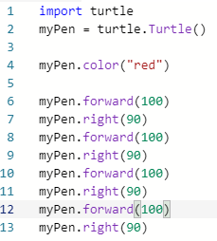
A Basic Turtle Program
Program to draw a red square.
Always begin with

Slide 5
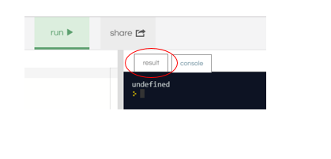
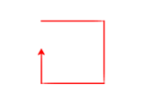
Viewing Output
Click the "Result" tab to see the drawing

Slide 6
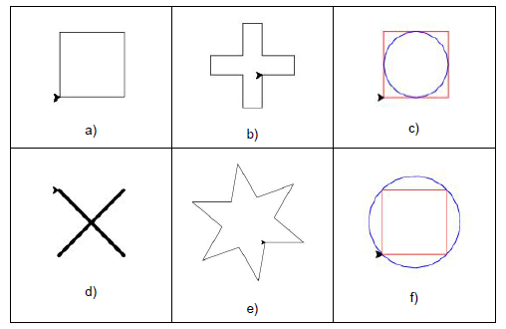
Basic Design Patterns
Try to recreate these patterns

Slide 7
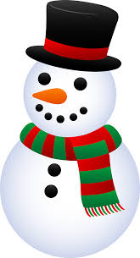


Christmas / Winter Theme Card
Use Python-Turtle and Your Creativity
Google "clipart" for ideas

